Slide 1
Functions in C
A function is a block of code that performs a specific task.
Types of function
Standard library functions
User defined functions
A. Standard library functions
The standard library functions are built-in functions in C programming to handle tasks such as mathematical computations, I/O processing, string handling etc.
These functions are defined in the header file. When you include the header file, these functions are available for use. For example:
The printf() is a standard library function to send formatted output to the screen (display output on the screen). This function is defined in "stdio.h" header file.
There are other numerous library functions defined under "stdio.h", such s scanf(), getchar() etc. Once you include "stdio.h" in your program, all these functions are available for use.

Slide 2
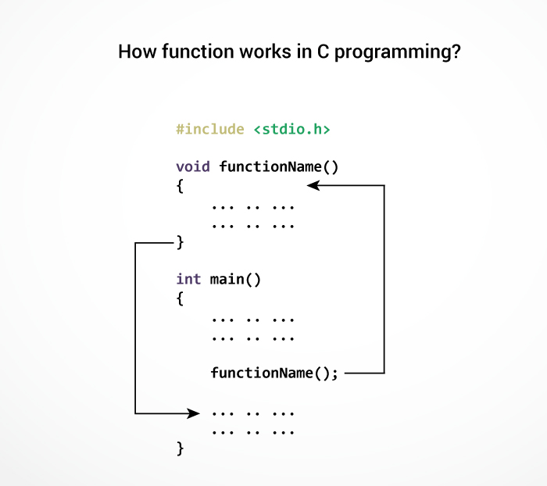
B. User defined functions
C allow programmers to define functions. Such functions created by the user are called user-defined functions.
You can create as many user-defined functions as you want.
Advantages of user-defined function
The program will be easier to understand, maintain and debug.
Reusable codes that can be used in other programs
A large program can be divided into smaller modules. Hence, a large project can be divided among many programmers.

Slide 3
#include <stdio.h>
int addNumbers(int a, int b); // function prototype
int main()
{
int n1,n2,sum;
printf("Enters two numbers: ");
scanf("%d %d",&n1,&n2);
sum = addNumbers(n1, n2); // function call
printf("sum = %d",sum);
return 0;
}
int addNumbers(int a,int b) // function definition
{
int result;
result = a+b;
return result; // return statement
}
Example: User-defined function

Slide 4
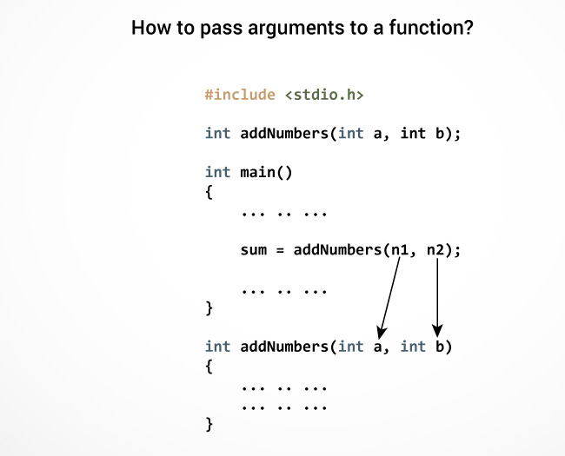
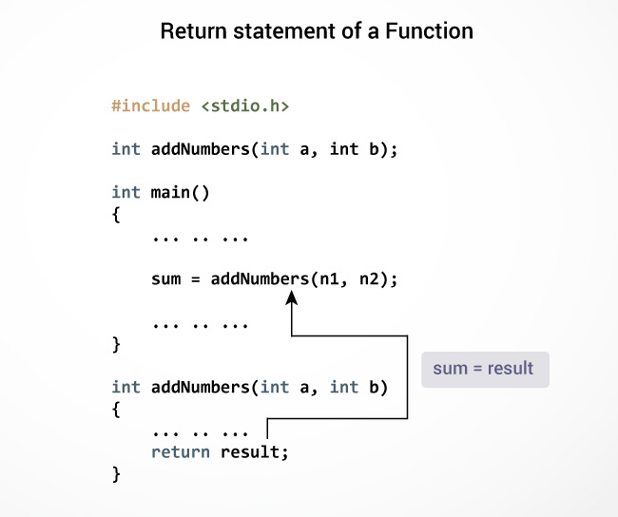

Slide 5
Types of User-defined Functions
No arguments passed and no return Value
No arguments passed but a return value
Argument passed but no return value
Argument passed and a return value

Slide 6
void checkPrimeNumber()
{
int n, i, flag=0;
printf("Enter a positive integer: ");
scanf("%d",&n);
for(i=2; i <= n/2; ++i)
{
if(n%i == 0)
{
flag = 1;
}
}
if (flag == 1)
printf("%d is not a prime number.", n);
else
printf("%d is a prime number.", n);
}
No arguments passed and no return Value
#include <stdio.h>
void checkPrimeNumber();
int main()
{
checkPrimeNumber();
return 0;
}

Slide 7
#include <stdio.h>
int getInteger();
int main()
{
int n, i, flag = 0;
n = getInteger();
for(i=2; i<=n/2; ++i)
{
if(n%i==0){
flag = 1;
break;
}
}
if (flag == 1)
printf("%d is not a prime number.", n);
else
printf("%d is a prime number.", n);
return 0;
}
No arguments passed but a return value
int getInteger() {
int n;
printf("Enter a positive integer: ");
scanf("%d",&n);
return n;
}

Slide 8
#include <stdio.h>
void checkPrimeAndDisplay(int n);
int main()
{
int n;
printf("Enter a positive integer: ");
scanf("%d",&n);
checkPrimeAndDisplay(n);
return 0;
}
void checkPrimeAndDisplay(int n)
{
int i, flag = 0;
for(i=2; i <= n/2; ++i)
{
if(n%i == 0){
flag = 1;
break;
}
}
if(flag == 1)
printf("%d is not a prime number.",n);
else
printf("%d is a prime number.", n);
}
Argument passed but no return value

Slide 9
#include <stdio.h>
int checkPrimeNumber(int n);
int main()
{
int n, flag;
printf("Enter a positive integer: ");
scanf("%d",&n);
flag = checkPrimeNumber(n);
if(flag == 1)
printf("%d is not a prime number",n);
else
printf("%d is a prime number",n);
return 0;
}
Argument passed and a return value
int checkPrimeNumber(int n)
{
int i;
for(i=2; i <= n/2; ++i)
{
if(n%i == 0)
return 1;
}
return 0;
}

Slide 10
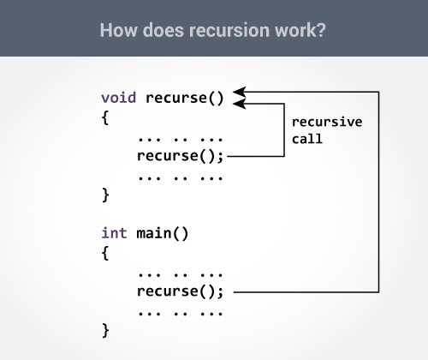
Recursion
A function that calls itself is known as a recursive function. And, this technique is known as recursion.

Slide 11
#include <stdio.h>
int sum(int n);
int main()
{
int number, result;
printf("Enter a positive integer: ");
scanf("%d", &number);
result = sum(number);
printf("sum = %d", result);
return 0;
}
Sum of Natural Numbers Using Recursion
int sum(int num)
{
if (num!=0)
return num + sum(num-1);
else
return num;
}

Slide 12
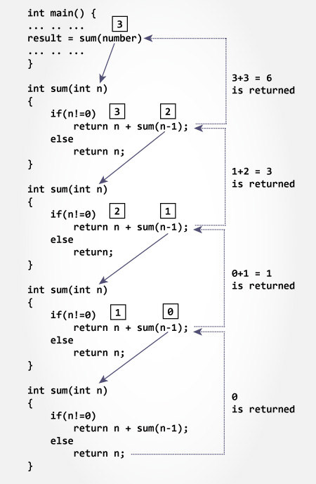
Advantages and Disadvantages of Recursion
Recursion makes program elegant and more readable. However, if performance is vital then, use loops instead as recursion is usually much slower.
Note that, every recursion can be modeled into a loop.

Slide 13
Scope and Lifetime of a variable
Every variable in C programming has two properties: type and storage class.
Type refers to the data type of a variable. And, storage class determines the scope, visibility and lifetime of a variable.
There are 4 types of storage class:
automatic / Local Variables
external / Global Variables
static Variables
register Variables

Slide 14
Local Variable
The variables declared inside the function are automatic or local variables.
The local variables exist only inside the function in which it is declared. When the function exits, the local variables are destroyed.
int main() {
int n; // n is a local variable to main() function
... .. ...
}
void func() {
int n1; // n1 is local to func() function
}
In the above code, n1 is destroyed when func() exits. Likewise, n gets destroyed when main() exits.

Slide 15
Global Variable
Variables that are declared outside of all functions are known as external or global variables. They are accessible from any function inside the program.
#include <stdio.h>
void display();
int n = 5; // global variable
int main()
{
++n; // variable n is not declared in the main() function
display();
return 0;
}
void display()
{
++n; // variable n is not declared in the display() function
printf("n = %d", n);
}
Output
n = 7
Suppose, a global variable is declared in file1. If you try to use that variable in a different file file2, the compiler will complain. To solve this problem, keyword extern is used in file2 to indicate that the external variable is declared in another file.

Slide 16
Register Variable
The register keyword is used to declare register variables. Register variables were supposed to be faster than local variables.
However, modern compilers are very good at code optimization and there is a rare chance that using register variables will make your program faster.
Unless you are working on embedded systems where you know how to optimize code for the given application, there is no use of register variables.

Slide 17
Static Variable
A static variable is declared by using keyword static. For example; static int i;
The value of a static variable persists until the end of the program.
#include <stdio.h>
void display();
int main()
{
display();
display();
}
void display()
{
static int c = 0;
printf("%d ",c);
c += 5;
}
Output
0 5
During the first function call, the value of c is equal to 0. Then, it's value is increased by 5.
During the second function call, variable c is not initialized to 0 again. It's because c is a static variable. So, 5 is displayed on the screen.

Slide 18
Thank You

